Slide 1
Marketing Analytics
Group Project 4 – Customer Lifetime Value

Slide 2
Overview of Problem
The objective here is to analyse the provided data and identify the lifetime value of a customer who buys from the store.
Also look at trends of sale in the year and try to understand which items have preformed well and which items could be substituted to get better sales.

Slide 3
About the Data Source
The data provided has the following fields, each line in the dataset corresponds to a particular item. A unique order can be identified using the Invoice number.
Invoice Number – Each Order has a unique Invoice number
Stock Code – Represents a single item, each item has a distinct Stock code
Description – Description of the Product
Quantity – Number of items ordered
Invoice Date – Date at which the order was placed
Unit Price – Price of one item
Customer ID – Unique to each customer
Country – Country where the order is placed

Slide 4
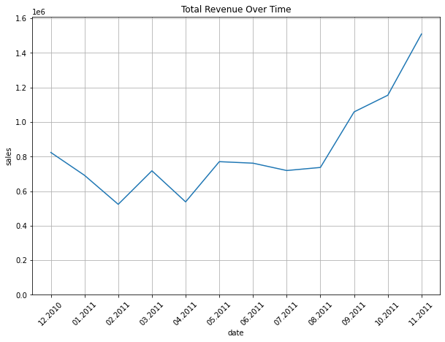
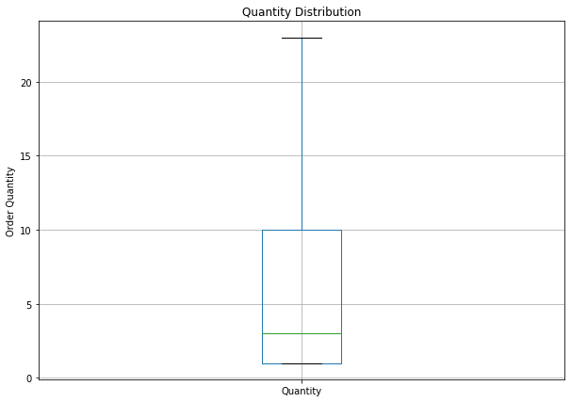
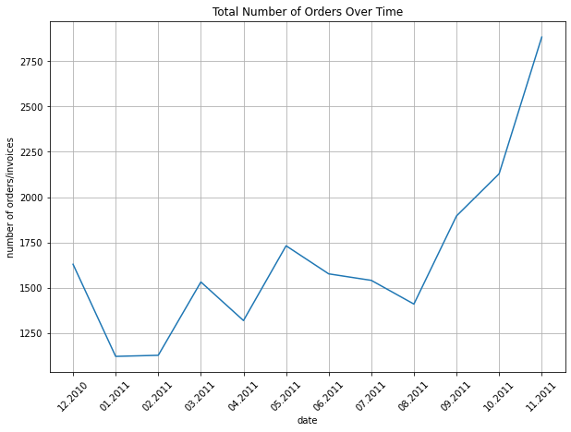
Descriptive Analysis
The revenue closely follows the total number of orders placed. Bring us the understanding that the more orders placed the better revenue we see. Most of the year the revenue is around 800K
Looking into the given dataset, the average quantity purchased is 3.
We have removed the negative values
from this field.
Analysing the total orders placed in the past one year we can see that the number of orders placed has increased steadily since Aug, we have removed the December of 2011 data because we only have data for the first 10 days
From the charts we can see that there is a corelation between the number of orders placed and the revenue. Meaning we will need to find products that sell more to ultimately make better revenue.

Slide 5
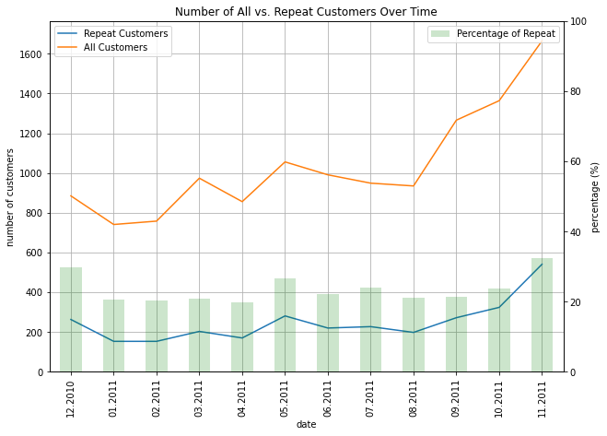
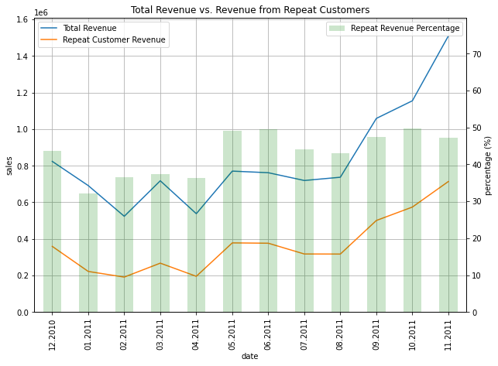
From the chart we can see a definite correlation between the total customers and the repeat customers, meaning attracting more customer would also help acquire a set of customers who frequent the shop.
The same cannot be said about the percentage of repeat customers as it stays consistent, fluctuating between 20 and 35%
Looking into the revenue from repeat customers and comparing it with the overall revenue we can see that even though only 20 to 35% of our customers are repeat, they contribute to anywhere between 40 to 50% of our overall revenue. Meaning converting a new customer to a repeat customer is priority.

Slide 6
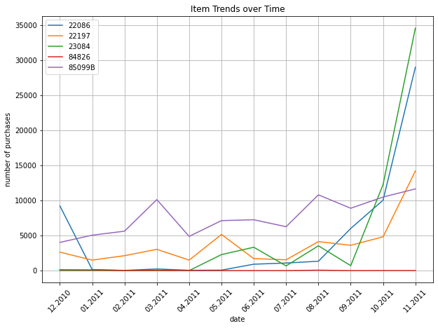
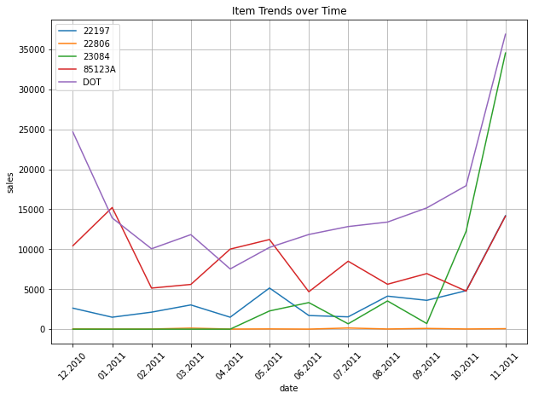
Looking into the sales of the products that have sold the maximum quantity we can see that 22197 (Orange) has performed consistently throughout the year whereas 23084 (Green) and 22086 (Blue) have had significant raise in the 10th and 11th month meaning they are seasonal and they can be stocked accordingly to make room for other products in the months when its demand is relatively low
Even though 22806 has performed very well in the previous plot we can see that compare to the other products it has not produced comparable sales, but this could be one of the products that has improved the foot traffic in the store.
Also the Product DOT although it hasn’t appeared in the previous plot has contributed to a significant portion of the sales here, same can be said about the 85123A product.
In contrast 23084 is a star product that has both sales quantity and sales making it one of our star products.

Slide 7
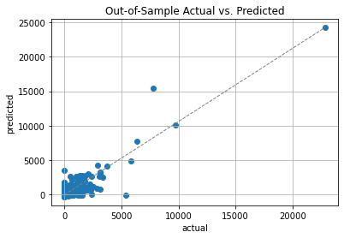
Regression Model Results
From the regression model we can see that the model is good at predicting sales in places when the values are high but does not perform particularly well for lower values, meaning we would need to consider an alternate approach to get more accurate predictions.

Slide 8
Recommendations
Stock inventory based on the seasonality of products, meaning stock less product when the sales are expected to be low and add more inventory when the season of sales for the product arrives
Increase the foot traffic into the store and provide offers to keep the customers coming back for more, this would eventually increase the stores revenue
Identify an alternate approach to predict sales/revenue that would be more reliable

